Slide 1

Entertainment Trivia
Rutgers Coding Bootcamp Project by:
Chandani Rana
Aaron Silverstein
Chae Kim

Slide 2
Agenda
Problem Statement
The Solution….Entertainment Trivia!
How Did You Did It?
So What’s Next?

Slide 3
Problem Statement
The bootcamp’s week 5 homework assignment to build a trivia game resulted in a very boring game!
Hard-coded questions and answers.
Not enough questions!
The questions may not even interest you.
Do you even want to play it twice?

Slide 4

The Solution….Entertainment Trivia!
A dynamic, content-rich Trivia Game for all ages!
Thousands of trivia questions from content provider.
Every game provides new questions.
Multiple categories of questions to meet your interests.
Are you a Trivia Pursuit Champion?
Challenging questions for the sharpest minds
Easy questions to get you started.
And keep track of how you’re doing over time!

Slide 5
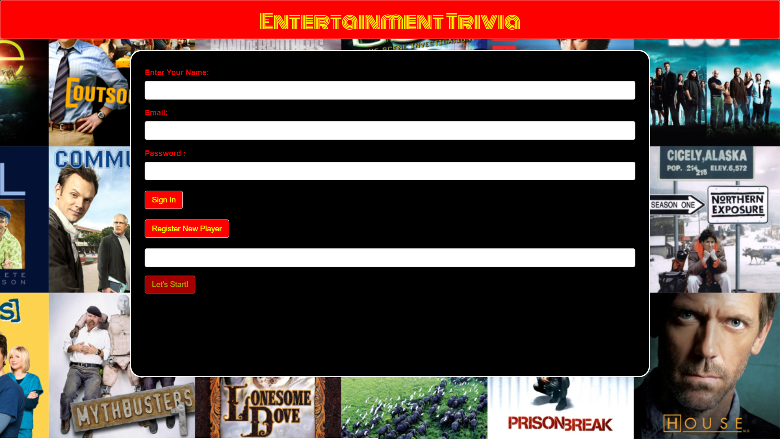


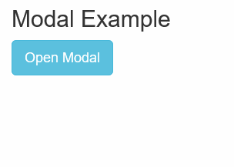


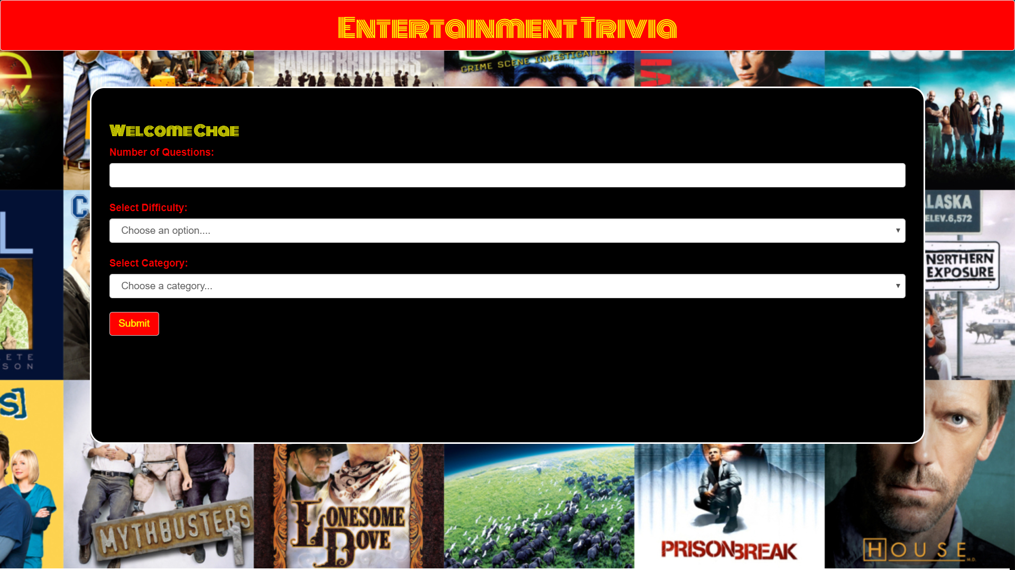



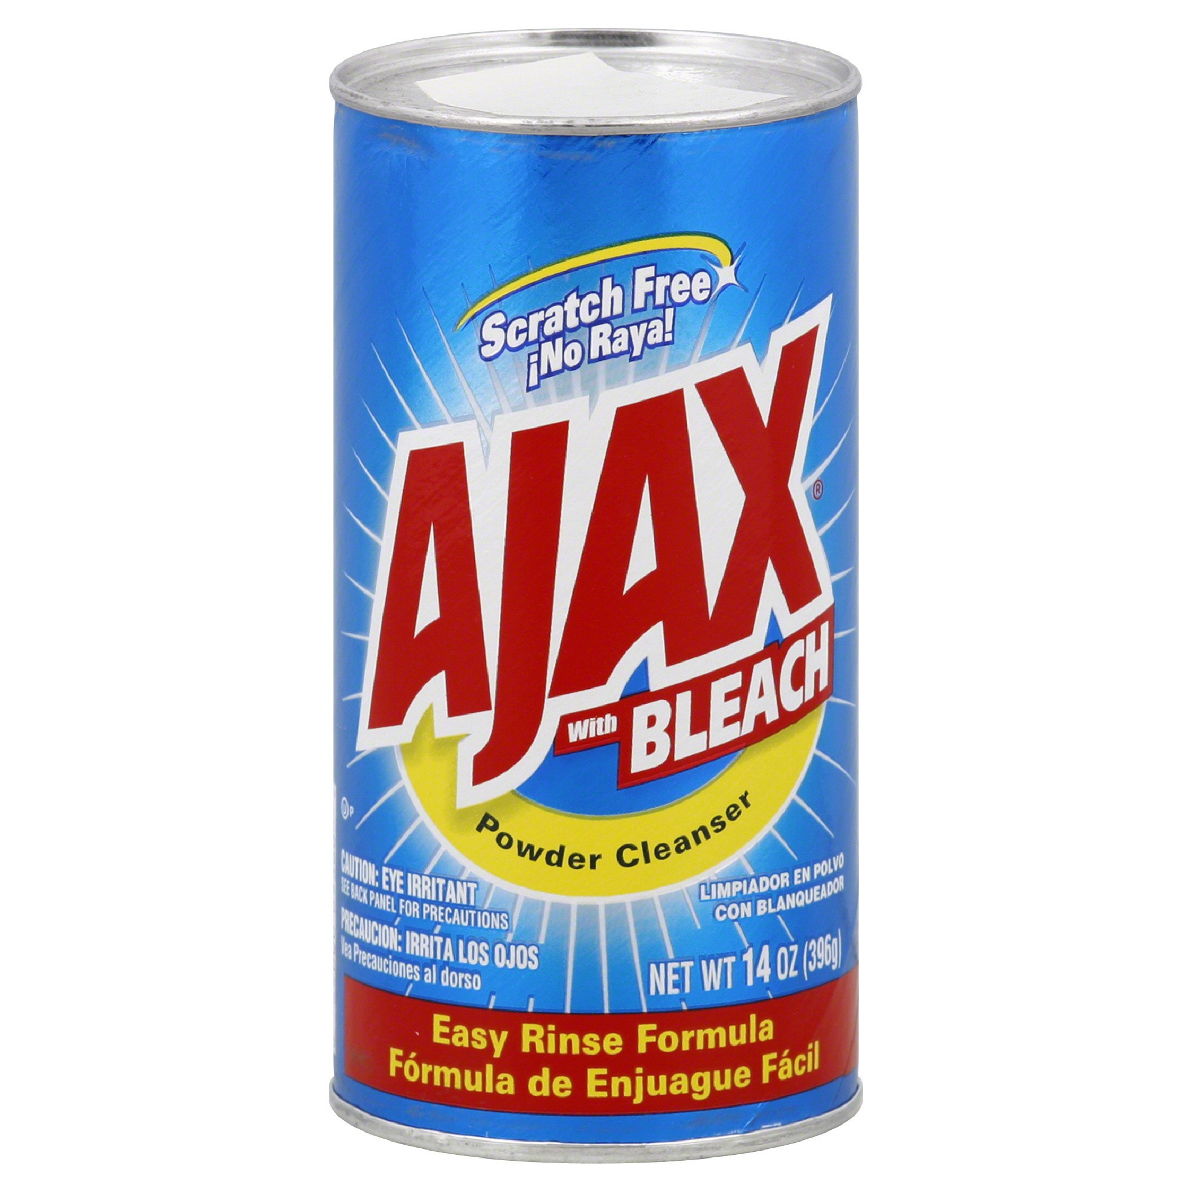
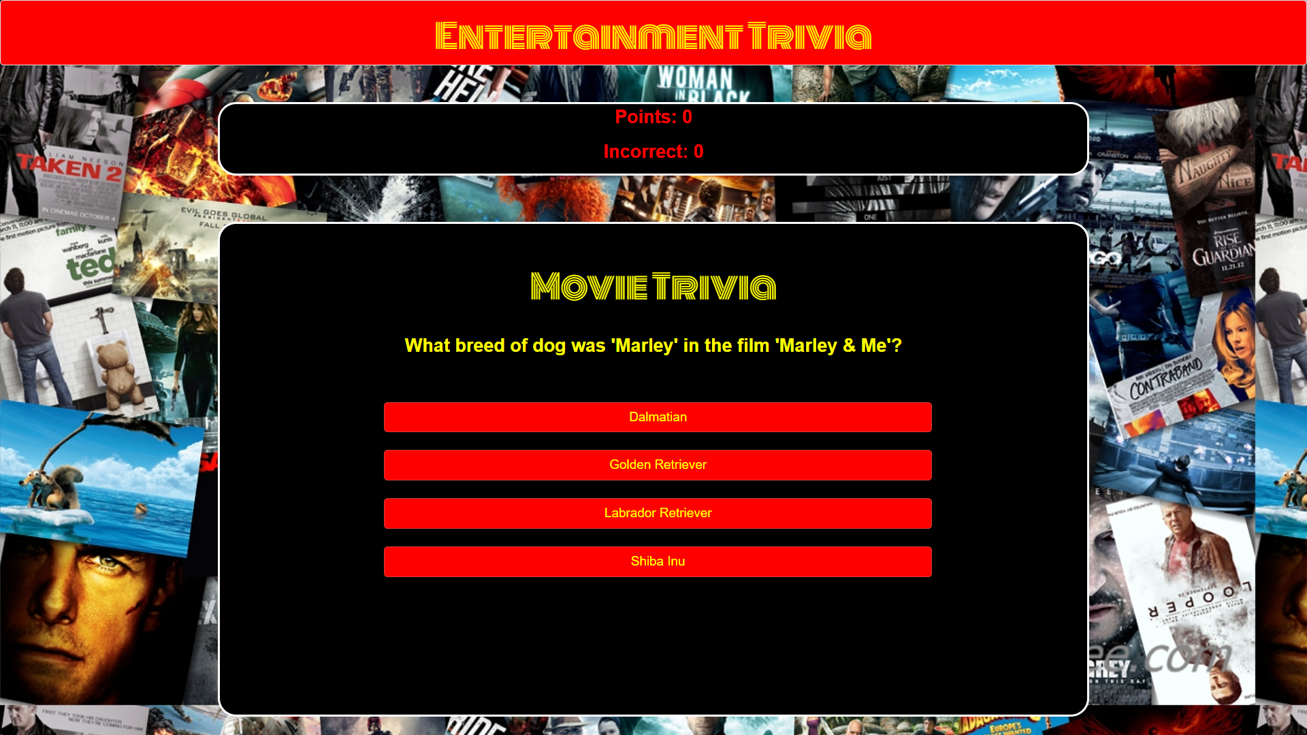
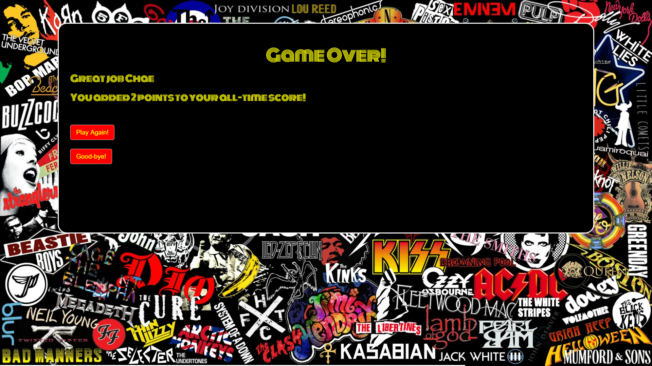

How Did You Do It?

Slide 6



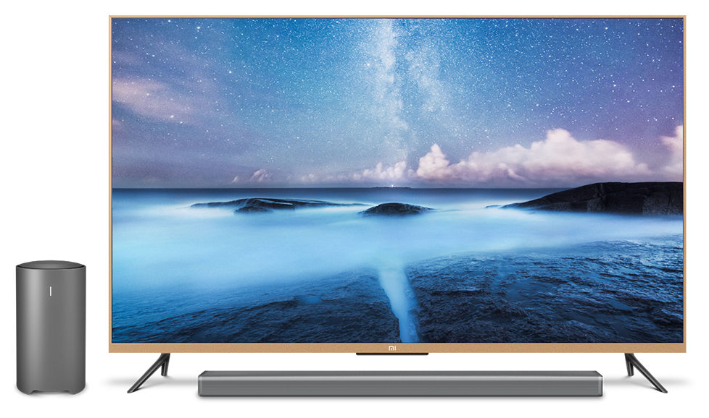


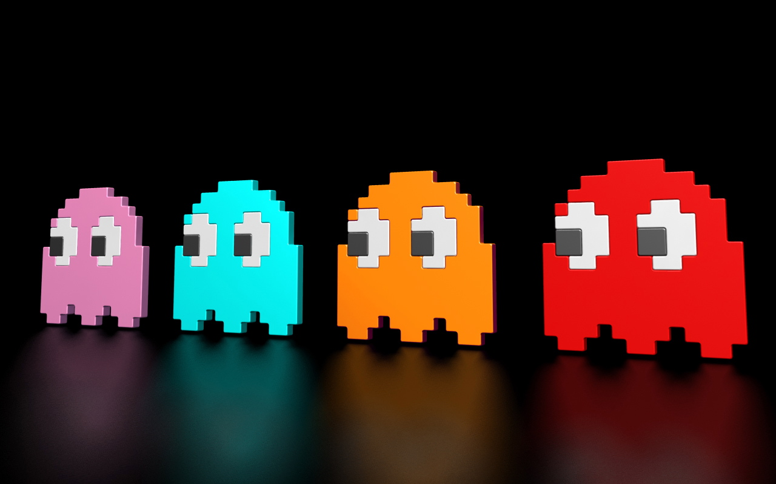
So What’s Next?
Historical Player Ranking System
Breakdowns who’s the best by:
Number of Games Played
Number of Correct vs Incorrect Answers
By Difficulty
By Category
Google Maps API integration
Are you the Entertainment Trivia Champion in your home town?
More Categories!
Grow market share by expanding into new categories…
Sports
Television
Video Games
Geography
Politics….and MORE!

Slide 7

Enough Talking…
Let’s Play!

